Slide 1

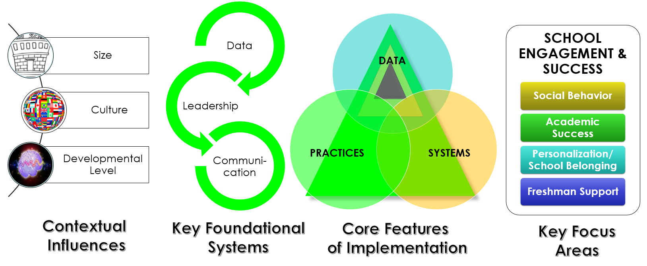


High School
Community of Practice #4
Hosted by:
AGENDA
Grounding:
High School Data Collection
9:30-10:30 AM Webinar with Jessica Swain-Bradway
Data for Decision Making in
High Schools – An Overview
CoP Processing Activity:
Precision Statements & Goals
12:30 – 1:30 Webinar with Jessica Swain-Bradway
Linking Data, Precision Statements and Solutions
CoP Processing Activity:
Solution Plans
“High School &
Data-based Decision Making”
April 26, 2017
Facilitated by:
Cristy Clouse
cristy@pbiscaltac.org

Slide 2
Critical Warning Indictors
available existing data housed at the school to:
Attendance | Attendance/Tardiness Chronic absenteeism
Behavior Social – Emotional | Office Referrals Suspensions Internalizing Behaviors Family Stressor Behavioral Screening
Coursework | Academic Screening Common Assessments Standardized Testing Grades Retention
Predict which students are at-risk for dropping out of high school or not moving to next level
Target resources to support off-track students while they are still in school before they drop out
Predict students who are not performing up to ability or are not college & career ready
Examine patterns and identify school climate

Slide 3
What Data
Collection System
are you using?
What Data
Decision Making System
are you using?
What data
are you collecting?
Attendance
Behavior Social – Emotional
Coursework

Slide 4
Team
Initiated Problem Solving
(TIPS)
What, Who, When, Where, and Why?
Identify Problem
with
Precision
How do we want the problem to change?
What next?
Make Summative
Evaluation
Decision
Identify
Goal for Change
Collect and Use Data
Has the problem been solved?
Monitor Impact
of Solution and
Compare
against Goal
Identify
Solution and
Create
Implementation
Plan with
Contextual Fit
Implement
Solution with
High Integrity
What are we going to do to bring about desired change?
Did we implement with fidelity?
Meeting
Foundations
Notes:
Use this slide to bring the TIPS II model “to life”
Reference the larger graphic (on chart paper or posted on wall) and highlight the point that if you fall off the wheel, you cannot effectively or efficiently reach problem solutions

Slide 5
Team
Initiated Problem Solving
(TIPS)
Identify Problem
with
Precision
Make Summative
Evaluation
Decision
Identify
Goal for Change
Collect and Use Data
Monitor Impact
of Solution and
Compare
against Goal
Identify
Solution and
Create
Implementation
Plan with
Contextual Fit
Implement
Solution with
High Integrity
Meeting
Foundations
Notes:
Start this step by asking if there is a problem
If one exists, then we must define it with precision

Slide 6
Team
Initiated Problem Solving
(TIPS)
Identify
Problem
with
Precision
Make Summative
Evaluation
Decision
Identify
Goal for Change
Collect and Use Data
Monitor Impact
of Solution and
Compare
against Goal
Identify
Solution and
Create
Implementation
Plan with
Contextual Fit
Implement
Solution with
High Integrity
Meeting
Foundations
Notes:
Start this step by asking if there is a problem
If one exists, then we must define it with precision

Slide 7
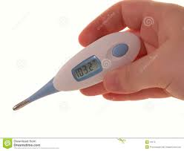
Defining a Problem with Precision
What?
different problems that will need
different solutions
103.2
When?
Why?
Where?
Who?
Notes:
Continues to highlight how based on different characteristics or precision elements (what other symptoms, who – is this an adult or an infant, when – for how long has this fever been present, where – oral or rectal temperature) we have different problems that will need different solutions. We know we have a problem but have to define it further before moving ahead.

Slide 8
A large group of freshman are displaying inappropriate behaviors in the quad. This cohort of students also is known to reside in less than positive neighborhoods many of which also come from households with older siblings who have been in an out of jail across the past years. Drugs, alcohol, and violent behavior are the norm on the streets around their homes.
Primary
Six 11th grade students are loitering in the halls in the morning and have accumulated more than 10 referrals for loitering and being tardy during the past month. It is believed that they are doing this in order to avoid homework reviews that take place in the class during that time.
Precise
Notes:
Point out that wordiness does not relate to precision as in the first example

Slide 9
WHAT WHERE WHEN WHO WHY
Bullying (verbal and physical aggression) in the commons is increasing during “first period” is being done mostly by thirteen 9th grade boys, and seems to be maintained by social praise from the bystander peer group.
Gang-like
behavior is
increasing.
Classroom behavior is aweful!
Classroom minor disrespect and disruption are increasing over time, and are most likely during the last 15 minutes of our first block periods when students are engaged in independent seat work. This pattern is most common in 9th and 10th grades, involves many students, and appears to be maintained peer attention.

Slide 10
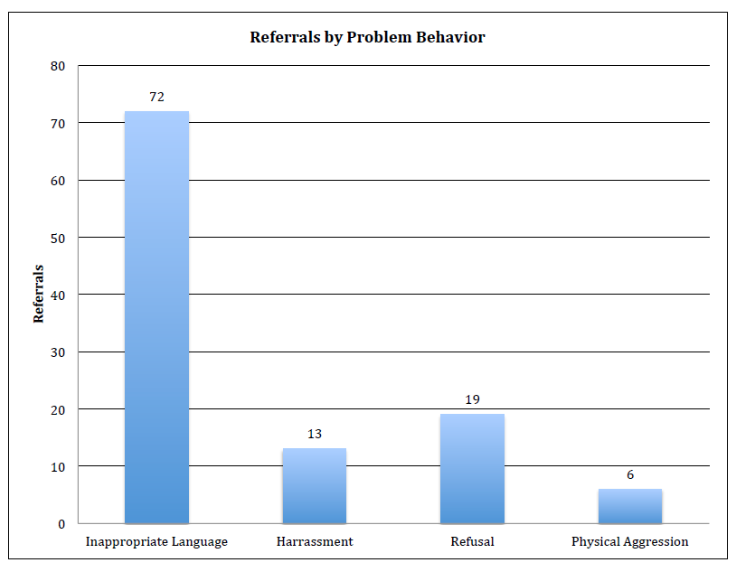
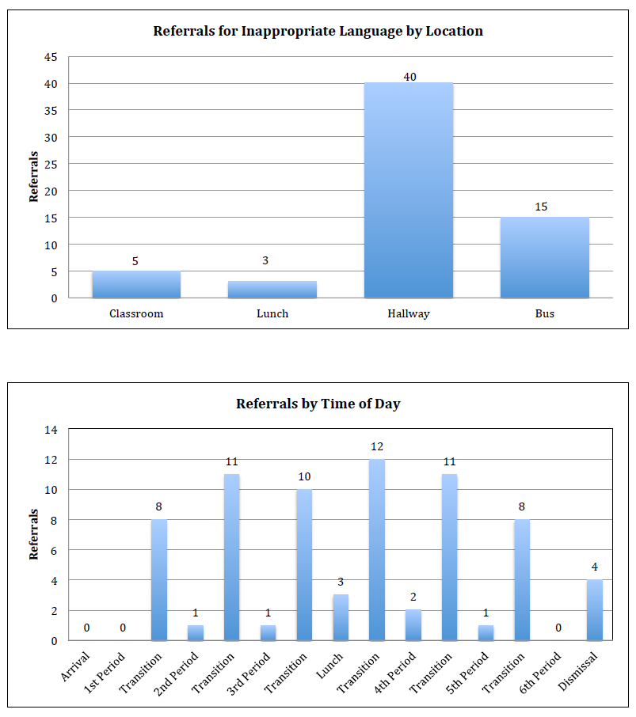
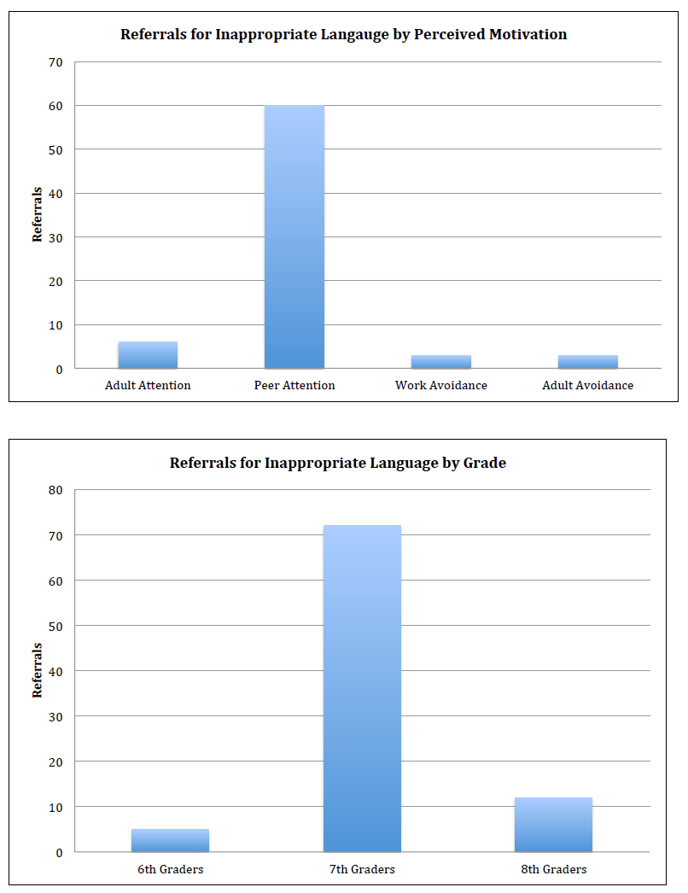
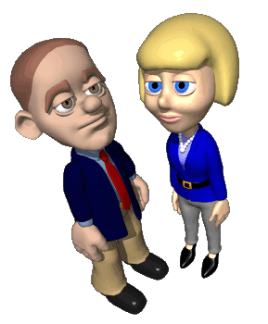
Create a Precision Statement
Data Scenario: Behavior/Office Discipline Referrals
9th
10th
11th
Notes:
examples

Slide 11
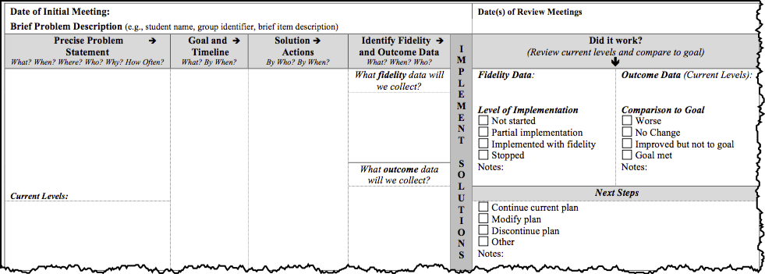
TIPS Meeting Minutes
  Many 8th graders are engaging in Defiance transitioning to fourth period with most of these instances occurring as students are arriving to class from lunchtime because the students want to avoid the upcoming classroom instructional period.
Now add “How Often” to this precise problem occurs.
Notes:
Next step is to identify the present levels of the behavior or skill set

Slide 12
Create a Precision Statement
Data Scenario: Academic/Individual Student
Notes:
examples

Slide 13
Team
Initiated Problem Solving
(TIPS)
Identify Problem
with
Precision
Make Summative
Evaluation
Decision
Identify
Goal
for Change
Collect and Use Data
Monitor Impact
of Solution and
Compare
against Goal
Identify
Solution and
Create
Implementation
Plan with
Contextual Fit
Implement
Solution with
High Integrity
Meeting
Foundations

Slide 14
GOAL
What?
By When?
Current: 38 referrals for Aggression during the past month
Current: 61% of 9th grade students meeting expectations in Algebra
Current: 1.5 referrals per day for defiance
Goal:
.5 or fewer referrals per day for Aggression
Goal:
1 or fewer referrals per week or .20 per day for defiance
Goal: 80% of 9th grade students meeting expectations in Algebra by Spring Benchmark
Goal:
.5 or fewer referrals per day for Aggression by March
Goal: 1 or fewer referrals per week or .20 per day for defiance by
April 1st
Goal:
80% of 3rd grade students meeting expectations in reading
Notes:
May hide this slide – use this to show additional goals with both What and By When components

Slide 15
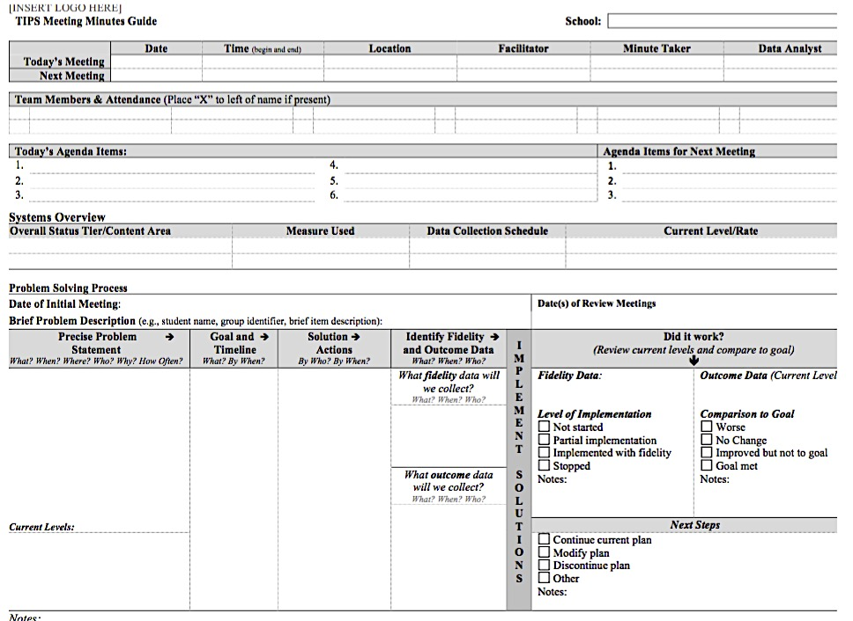

Slide 16
Team
Initiated Problem Solving
(TIPS)
Identify Problem
with
Precision
Make Summative
Evaluation
Decision
Identify
Goal for Change
Collect and Use Data
Monitor Impact
of Solution and
Compare
against Goal
Identify
Solution and
Create
Implementation
Plan with
Contextual Fit
Implement
Solution with
High Integrity
Meeting
Foundations

Slide 17
SOLUTION ELEMENTS | ACTION STEPS
Prevent | Focus on prevention first. How could we reduce the situations that lead to these behaviors?
Teach | How do we ensure that students know what they SHOULD be doing when these situations arise?
Reinforce | How do we ensure that appropriate behavior is recognized?
Extinguish | How do we work to ensure that problem behavior is NOT being rewarded?
Correct | How will you correct errors?
Safety | Are additional safety precautions needed?

Slide 19

CLOSING CIRCLE
Essential Question:
What are the considerations for high school and data-based decision making?
A conversation I enjoyed….
A deeper understanding of …
An idea to share with my staff back at school…
A next step …
A feeling I am leaving today with …. because…
An “ah ha” moment …

